Slide 1
APA Style—Part I
Basic Formatting
References Page Formatting

Slide 2
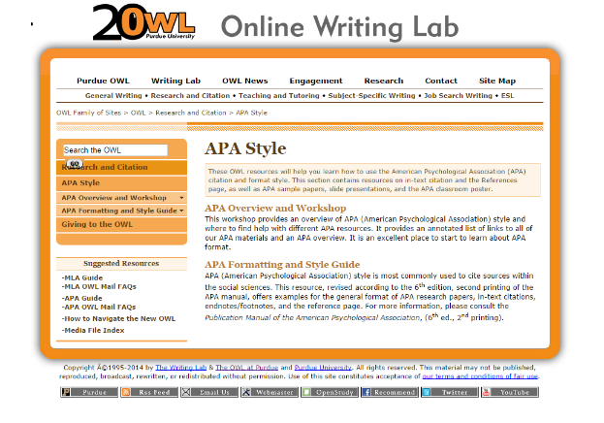
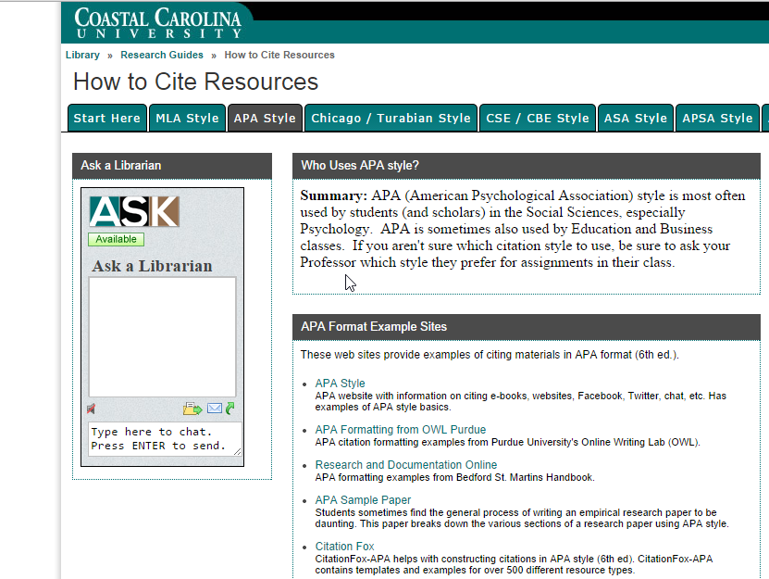
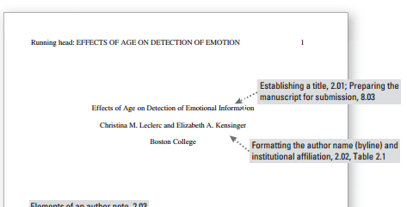
Valuable Resources
Purdue OWL
Kimbel Library Citation Guide
Sample Paper

Slide 3
Paper Formatting Basics
Set one inch margins all around.
Choose Times New Roman, 12 pt. font.
Create a title page (unless instructor says otherwise).
Insert title page header (“Running head:” and shortened title plus page number)
Insert body page header (shortened title plus page number)
Last page=References page

Slide 4
Paper Formatting—MS Word Issues
MS Word uses 1.25 as the default left and right margins. You need to reset these margins to 1 inch under the Page Layout>Margins tab.
MS Word uses 11 pt. Calibri font as the default font. You need to reset this font/size choice to 12 pt. Times New Roman on the Home tab.
MS Word puts extra space between paragraphs in the default setting. You need to reset this spacing to zero (0) extra points of spacing under the Paragraph>Spacing tab.

Slide 5
References Page Formatting Basics
Center the title “References” (with no quotation marks) one inch below the top of a new page.
Include a header on this page, too.
List the works in alphabetical order by author.
If the author is not available, alphabetize by title.
Each entry is double spaced, with no extra space between entries
Use the same 12 pt. Times New Roman font as in the rest of the paper.
Use a hanging indentation of ½ inch in each entry.
Do not number the entries.
For article and book titles, use “sentence capitalization.”
For magazine/journal titles, use “book capitalization.”

Slide 6
References Page—Individual Entries
Memorize this order of information for entries:
Author’s name
Date
Title
Publication information (date, volume, city of publication, etc.)
Know that each form is slightly different. There are forms for books, journal and magazine articles, newspaper articles, web sites, video recordings, and other types of entries.
Look up the right format for each source.
Insert the http address for web pages (unlike MLA).
Do not trust an automated online citation service or citation-generating software to format your entries correctly. The responsibility is yours.

Slide 7
Questions?
Writing Center
Kearns 203
(843) 349-2937

